Slide 1
Capstone Project
Hotel Booking Analysis
By Ayush Kumar

Slide 2
Points for Discussion
Data Summary
Data Preparation & Cleaning
Hotel Types
Cancellations
Cancellations by Deposit Type
Lead Time & Cancellations
Bookings & Cancellations by Months
Avg. Daily Rate over Months
Bookings by Country
Bookings & Cancellations by Market Segments
Correlation of features
Distribution of ADR
Car Parking Space
Room Types
Top Agents
Special Request by Country
Lead Time
Bookings by Distribution Channel
Meals
Previous cancellations & Cancellations
Repeated Guests
Conclusions

Slide 3
Data Summary
The Hotel Booking Dataset contains booking information for city and resort type hotels mainly in the years 2015, 2016 and 2017. It includes information like when the booking was made, length of stay, the number of adults, children and babies, and the number of available parking spaces, meals etc. All personally identifying information has been removed from the data. This dataset contains more than 119,000 rows of data.

Slide 4
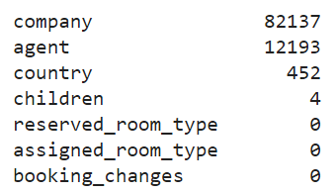
Data Preparation & Cleaning
There were 31994 duplicate data, so deleted those rows.
4 columns (company, agent, country & children) had missing values.
There may be some cases when customer didn't booked
hotel via any agent or via any company. Hence we will replace
null values by 0 in these columns.
children column is numeric and skewed, hence choose median for imputing missing values.
country column is categorical column. We use mode of ‘country’ column, But it can lead to bias towards a specific country that occurs most frequently in the data. Hence I created a new category ‘others’ for missing values.

Slide 5
Data Preparation & Cleaning
There were 166 rows with 0 adults, children and babies which seems unlikely hence dropped them.
Created new column for total_guest = (adults + children). Ignored babies because generally they are not charged.
Some values in ‘adr’ was negative, which must be an error so imputed them with median since it was a skewed data.
Created new column for total_stays_night = (weekend_nights + week_nights) to analyze average length of stay.
Assigned appropriate data types for some columns.

Slide 6
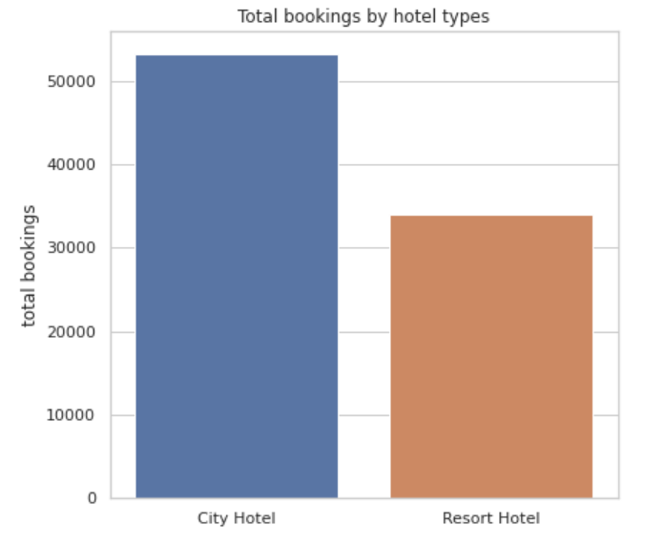
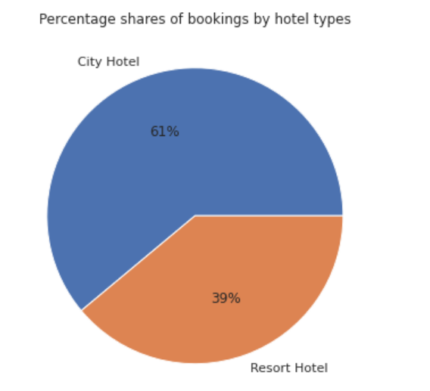
Hotel Types
There are two types of hotels:
City Hotel
Resort Hotel
There are around 52k bookings in City Hotels which is 61% of total bookings in the dataset, similarly around 34k bookings (39%) in Resort Hotels.

Slide 7
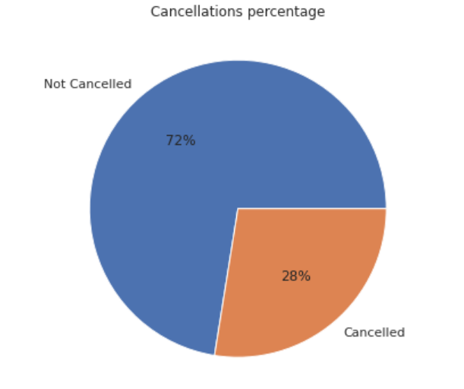
Cancellations
Out of all the bookings, 28% of them was cancelled and 72% was not cancelled.

Slide 8
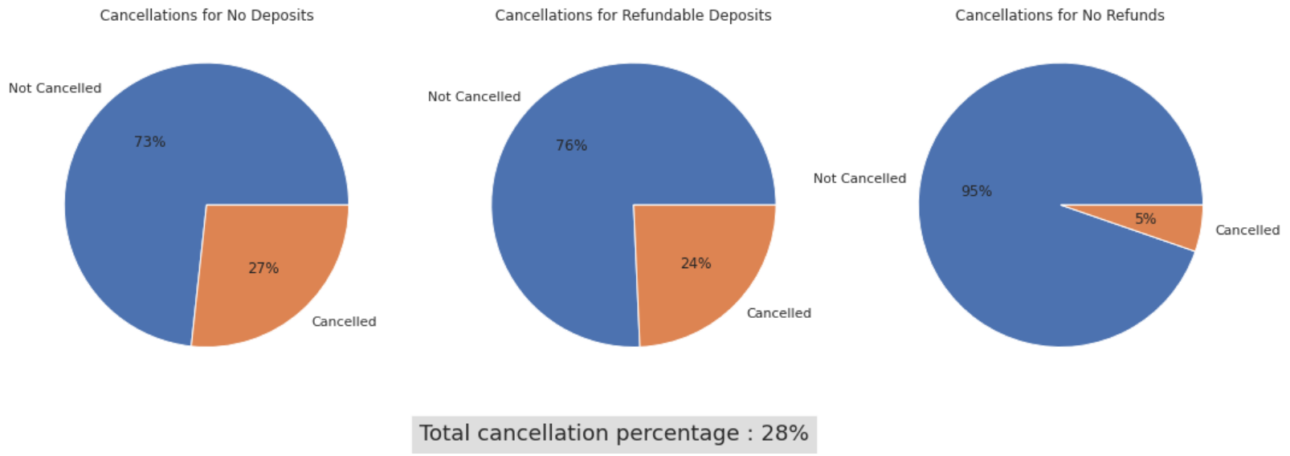
Cancellations by Deposit Type
Around 1/4th of bookings were cancelled where customer will get the money back. Only 5% cancels their bookings when they can't get their money back.

Slide 9
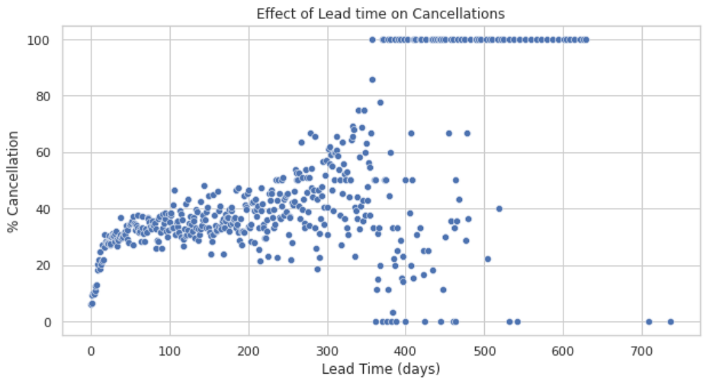
Lead Time vs Cancellations
Bookings having less lead time are less often cancelled whereas high lead time bookings are more often cancelled.

Slide 10
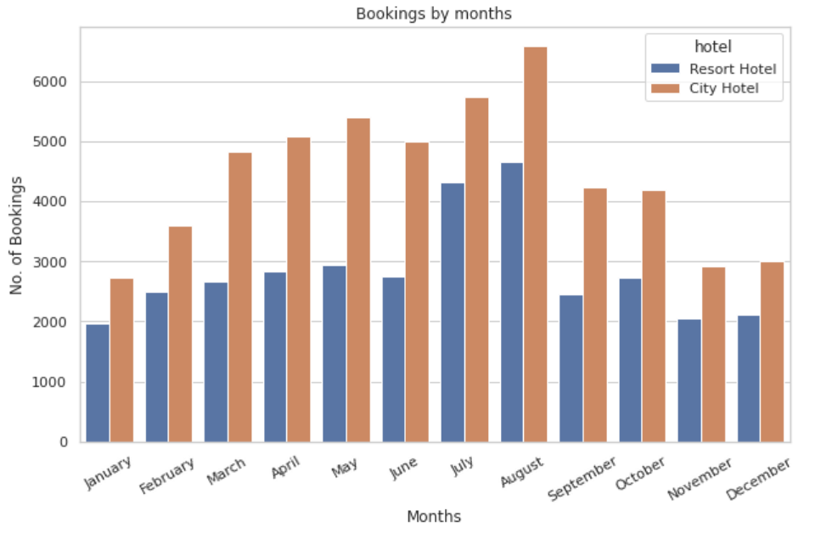
Monthly Bookings
For both hotel types, winter months have less bookings compared to mid-year (or summer) months.

Slide 11
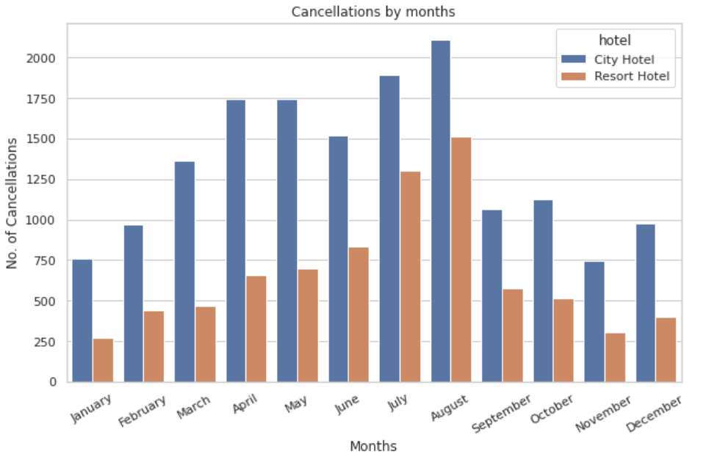
Monthly Cancellations
Graphs for total bookings and total cancellations for both hotel types are similar which means with more number of bookings, more are the cancellations.

Slide 12
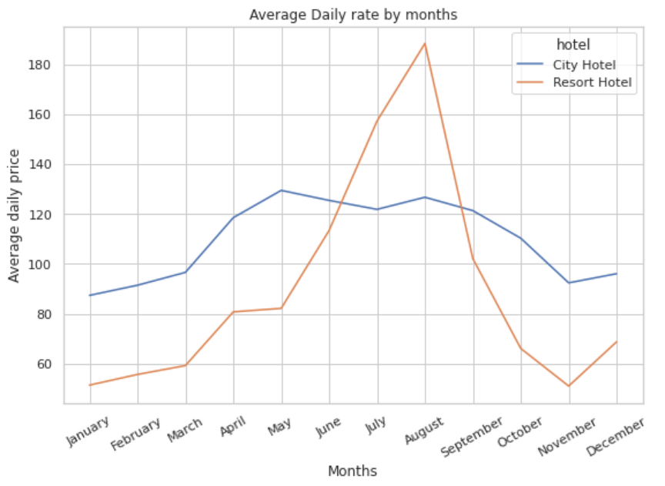
Daily Rates by Months
adr is higher in summer months and lower in winter months, and we saw the similar pattern in total bookings over months. Simple market principle i.e., more demand more price and less demand less price.

Slide 13
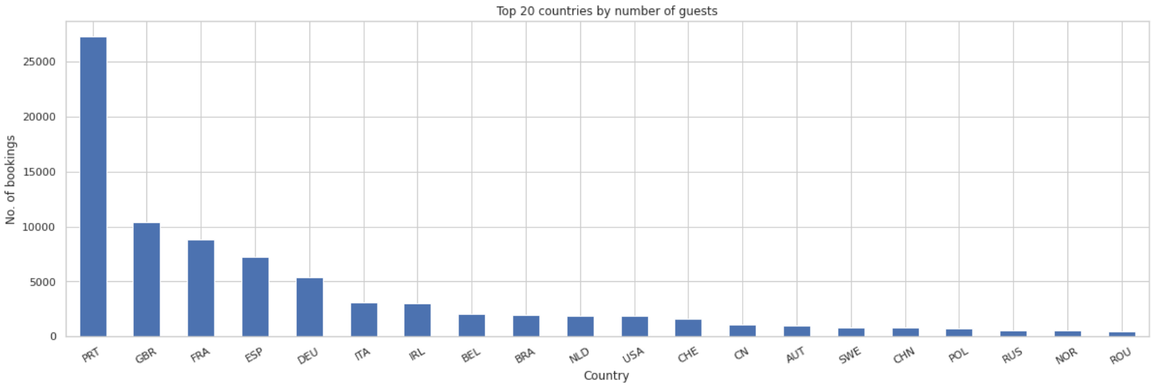
Bookings by Country
Portugal has significantly higher number of bookings compared to other countries. Next major countries are GBR, FRA, ESP etc. Most of the top countries are European countries.

Slide 14
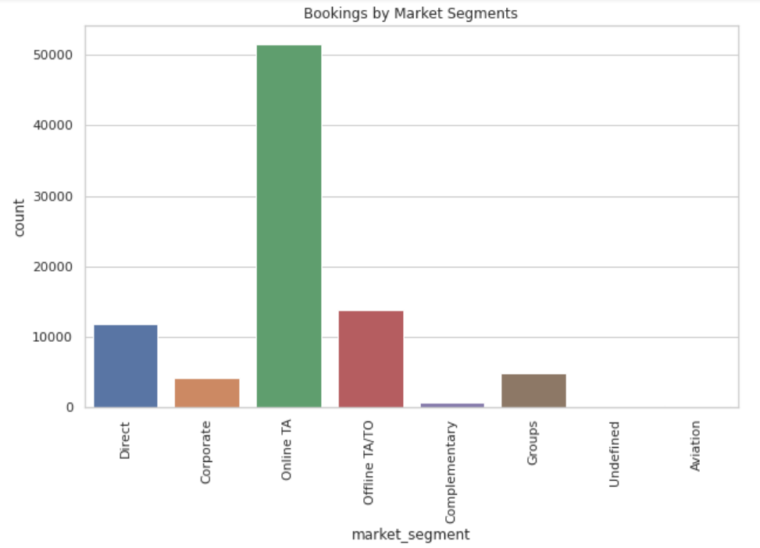
Bookings by Market Segments
Indirect bookings through travel agents (specially Online) are higher compared to other bookings like direct, corporate, group etc.

Slide 15
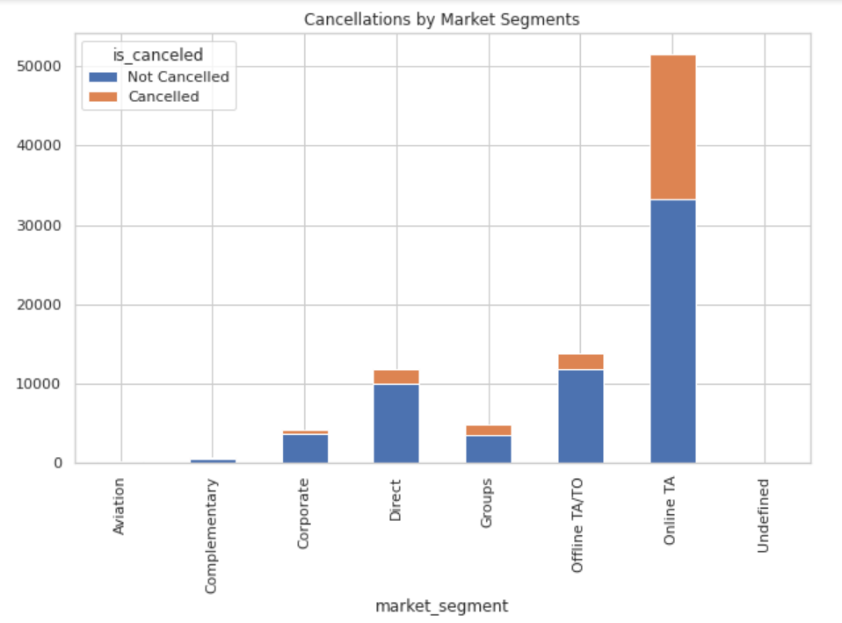
Cancellations by Market Segments
We see that Online TA has highest proportion of cancellations (around 35%) but at the same time number of non cancelled bookings are also the highest for Online TA. Cancellation proportions for other segments are less.

Slide 16
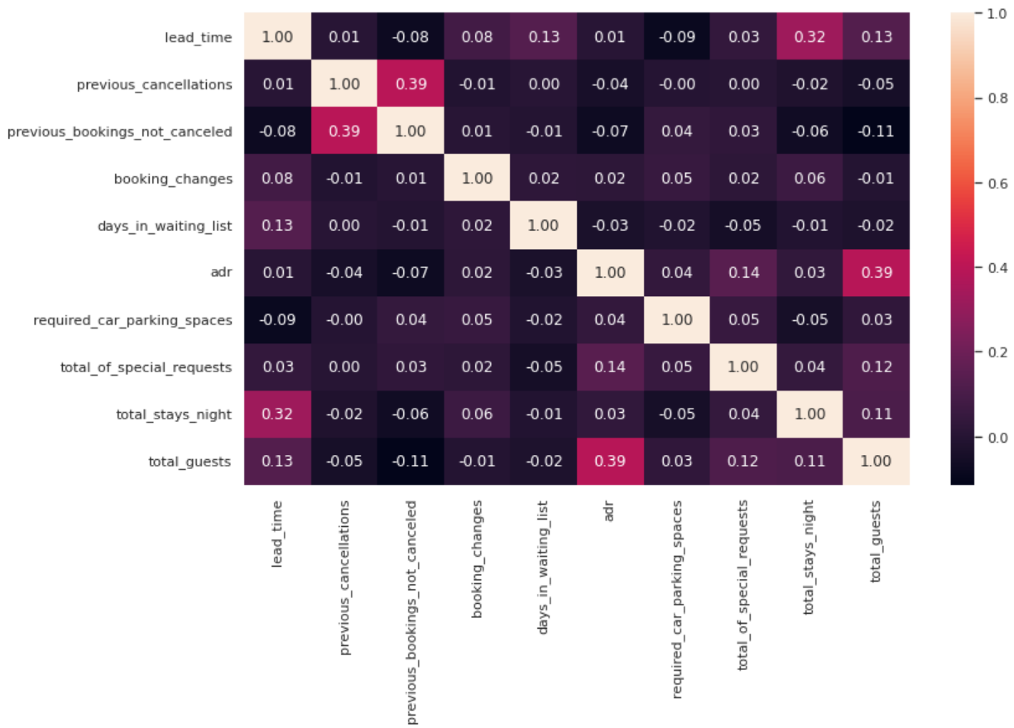
Correlation of features
Lead time and total stays night have little correlation. This may indicates that people who wants to stay longer generally plans early hence longer lead time.
adr and total guests are also slightly correlated, which makes sense as more number of people means more cost/charges.

Slide 17
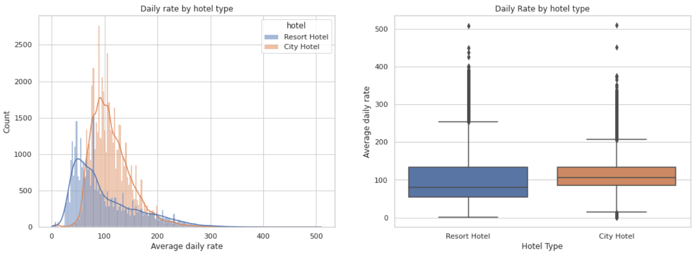
Daily Rate Distribution

Slide 18
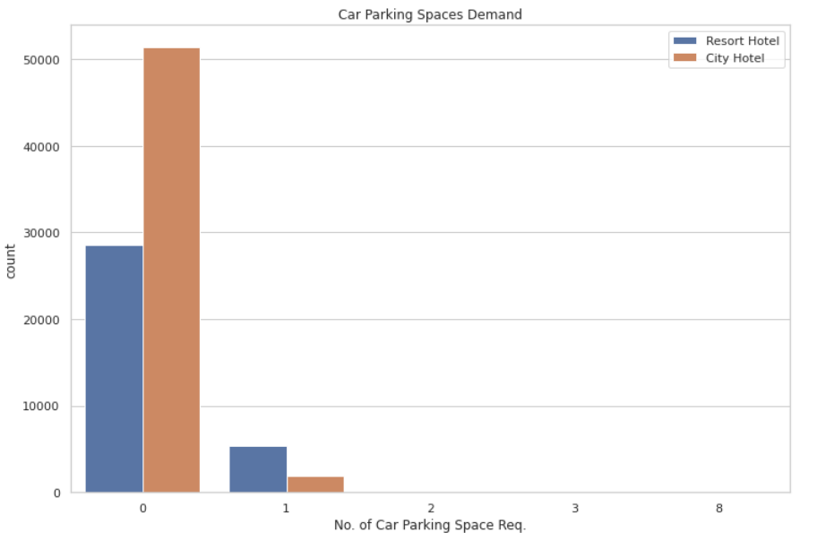
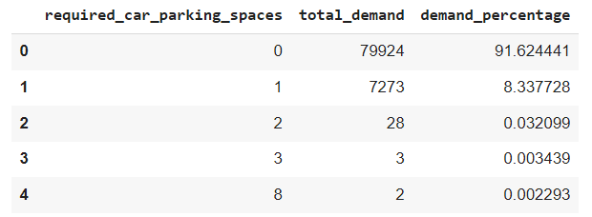
Car Parking Space
More than 91% guests don't need parking space.
Approx. 8% guests need parking space for 1 car.

Slide 19
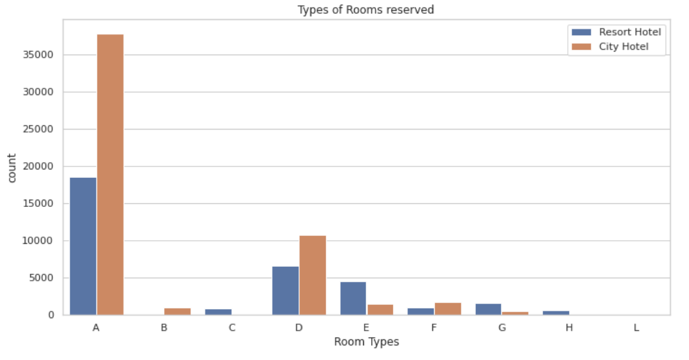
Room Types
Most of guests reserves rooms of type 'A', also significant number of guests also reserves room type 'D' & 'E'. Demand for rest types are very minimal.

Slide 20
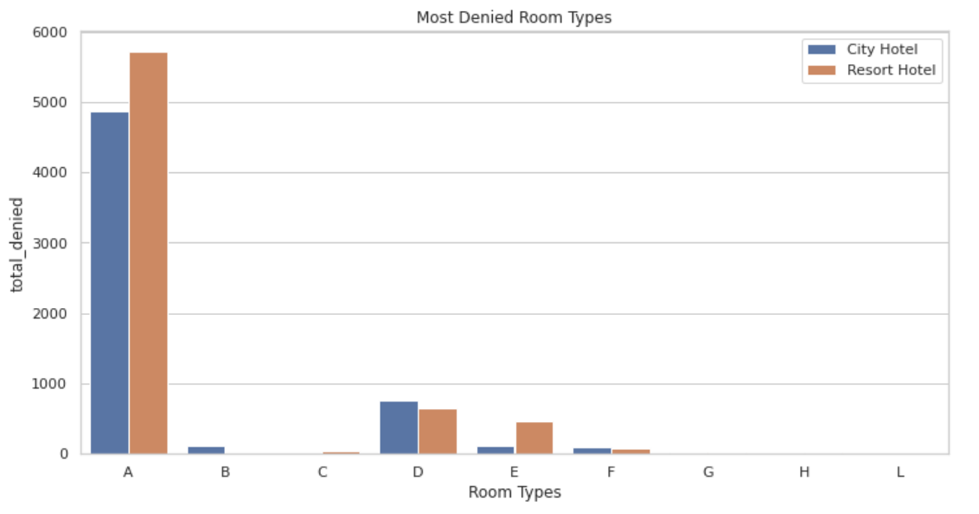
Room Types
Similar to number of bookings, room type ‘A’ has most number of denials. Followed by ‘D’ and ‘E’ etc.

Slide 21
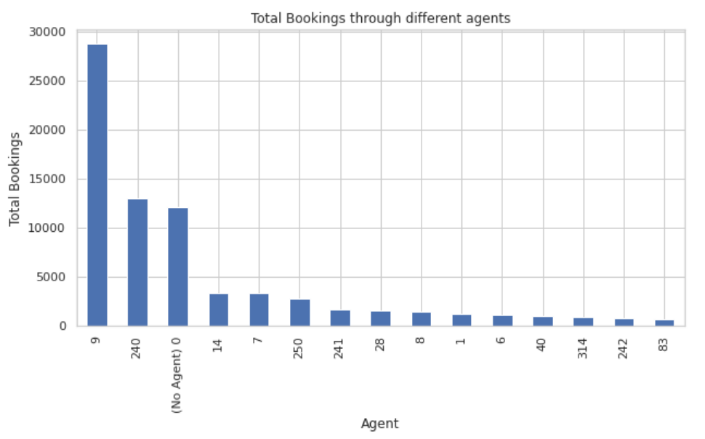
Top Agents
Agent no. 9 has made most no. of bookings followed by 240, 14 etc.

Slide 22
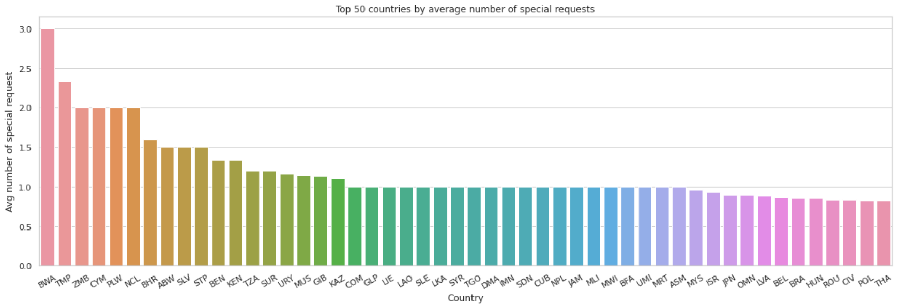
Special Requests by Country
Botswana, East Timor, Zambia are some countries with highest number of special requests.

Slide 23
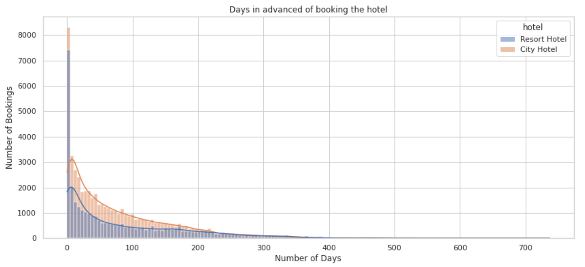
Lead Time
Majority of the bookings are done within 100 days of check-in date to the hotel.

Slide 24
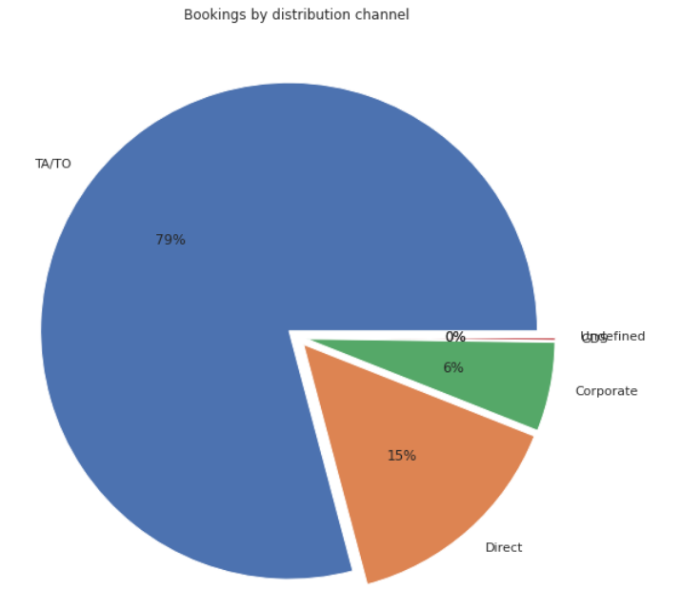
Bookings by Distribution Channel
Around 79% of bookings are done through TA/TO distribution channel.
Other major distribution channels are Direct and Corporate.

Slide 25
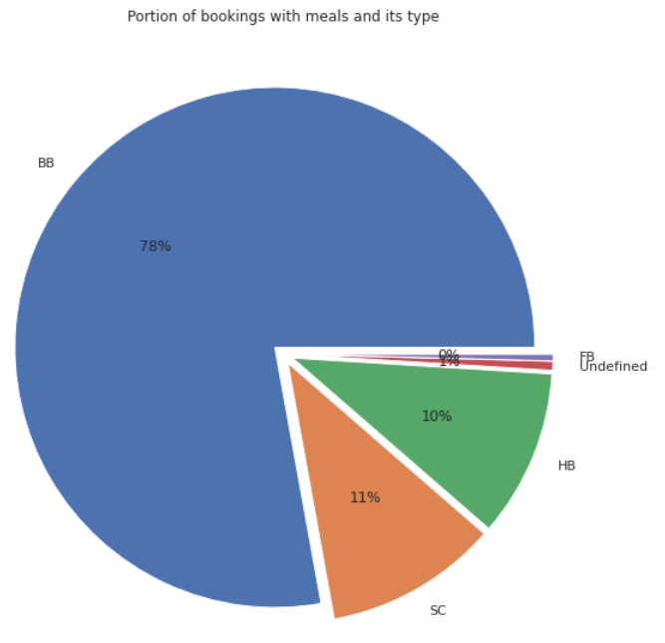
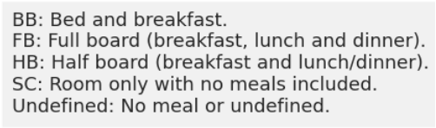
Meals
Almost 90% of total guests books meal in their bookings, among which majority books meal of type BB (78%) followed by SC (11%), HB (10%) etc.

Slide 26
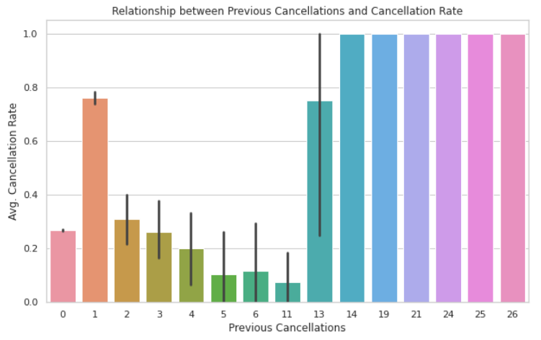
Previous and Current cancellations
Those who have cancelled previously once have high chance of cancellation compared to 0 previous cancellations. For higher values of previous cancellations, numbers are very less and can be ignored.

Slide 27
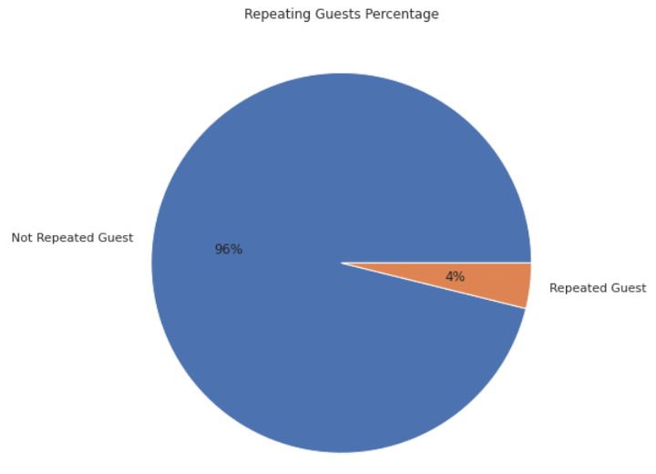
Repeated Guests
Around 4% of total bookings are made by repeated guests. So majority bookings are from new customers.

Slide 28
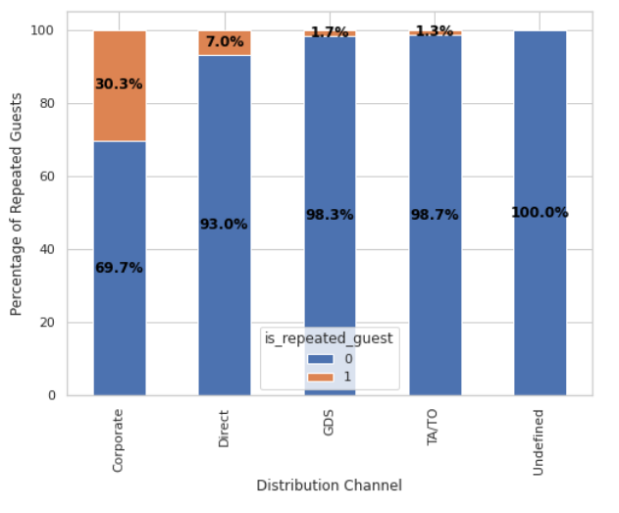
Repeated Guests by Distribution Channel
Corporate has most number of repeated guests followed by Direct, GDS etc.

Slide 29
Conclusions
City Hotels have more bookings (61%) compared to Resort Hotels (39%).
Non-refundable deposits decreases significantly the chances of cancellation.
Longer lead time increases the chances of cancellations.
Summer months (April to August) have more bookings compared to winter months.
Portugal has the highest number of customers followed by Britain, France etc.
More bookings comes through TA/TO (Online/Offline) compared to Direct, Corporates etc.
Most customers don't need parking space around 91%.
Room Type A is the most preferred room type among customers.
Agent no. 9 has made most no. of bookings followed by 240, 14 etc.
Almost 90% of total guests books meal in their bookings, among which majority books meal of type BB (78%) followed by SC (11%), HB (10%) etc.
Corporate has the most percentage of repeated guests while TA/TO has the least whereas in the case of cancelled bookings TA/TO has the most percentage while Corporate has the least.

Slide 30
Thank You!

